Slide 1

TruthGuard: AI-Powered Fake News Detection & Verification Tool
Infosys Springboard Virtual Internship 6.0
Name: Aditya Gupta Batch 10
Fighting misinformation with intelligent automation for a safer digital society.

Slide 2
The Escalating Challenge of Misinformation
The pervasive spread of misinformation across social media platforms poses a significant threat to informed public discourse and societal stability. The sheer volume and velocity of content render traditional, manual fact-checking methods unsustainable and unable to scale effectively.
Rapid Dissemination
Manual Limitations
Erosion of Trust
Misinformation spreads exponentially faster than verified truths, often leveraging emotional appeals.
Human fact-checkers are overwhelmed by the scale, leading to delays and missed critical instances.
Unchecked falsehoods undermine public trust in institutions, media, and shared realities.

Slide 3





TruthGuard: Key Project Outcomes
TruthGuard delivers a robust, automated solution designed to combat misinformation through intelligent verification and clear insights.
Automated Credibility Assessment
Real-Time Verification
Leverages external APIs for instantaneous data cross-referencing.
Provides a precise 0-1 score, indicating content trustworthiness.
High Performance
Explainable AI (XAI)
Achieves verification responses in under 100 milliseconds.
Highlights specific suspicious text segments for user understanding.

Slide 4
TruthGuard: Modular Architecture Overview
TruthGuard is structured into seven distinct modules, each responsible for a critical aspect of the detection and verification process.
01
02
03
User Authentication
Input Processing (Text/URL)
NLP & Feature Extraction
Secure login and session management for authorized access.
Handles diverse input formats, preparing them for analysis.
Extracts linguistic and contextual features crucial for credibility assessment.
04
05
06
Classification (Hybrid)
Claim Verification
Explainability
Combines rule-based logic with advanced AI models for robust detection.
Cross-references information with external, reliable sources.
Provides transparency by pinpointing reasons for a credibility score.
07
Admin Dashboard
Centralized control panel for system monitoring and management.

Slide 5
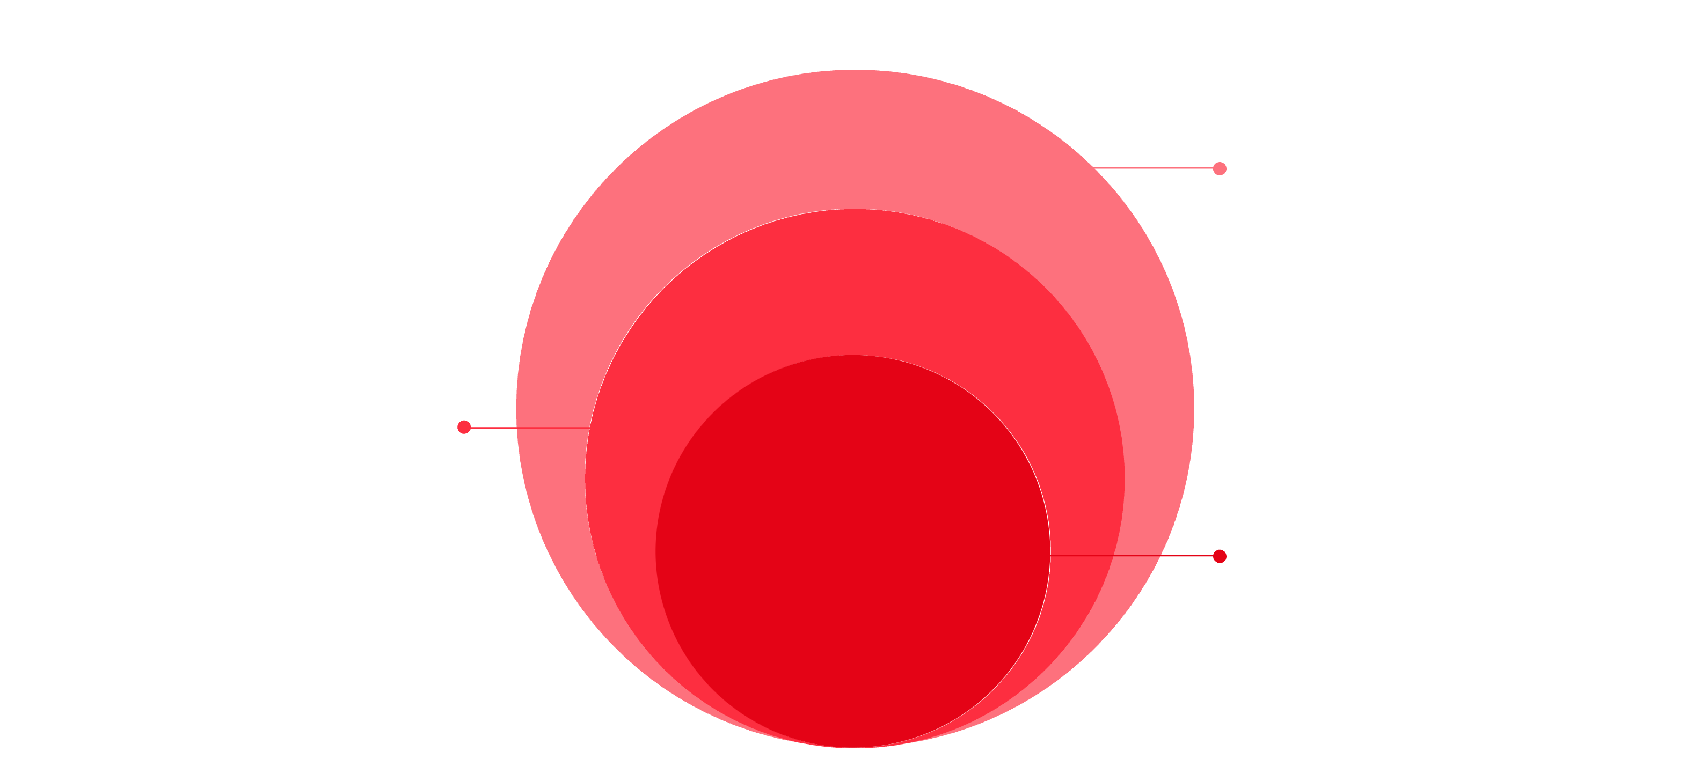
TruthGuard: System Architecture
Our 4-layer architecture ensures scalability, maintainability, and robust performance.
Business Logic
FastNewsDetector and GeminiAssistant
Data Access
SQLAlchemy ORM manages DB interactions
Core Storage
SQLite for durable local storage

Slide 6
Technology Stack: Powering TruthGuard
TruthGuard leverages a modern and efficient tech stack to deliver its advanced capabilities.
Python
Flask
Primary language for development and AI model implementation.
Lightweight web framework for rapid API and web interface development.
Google Gemini AI
NLTK/spaCy
Advanced AI for sophisticated natural language understanding and generation.
Robust NLP libraries for text processing and feature extraction.
Bootstrap 5
SQLite
Responsive front-end framework for a clean and intuitive user interface.
Lightweight, file-based database for efficient data storage.

Slide 7
TruthGuard: Database Schema
A well-defined database structure is critical for efficient data management and retrieval.
Users
Stores user authentication details.
id, username, password_hash
One-to-many with Analysis
Analysis
Records each content analysis, classification, and score.
id, user_id, input_text/url, classification, score, timestamp
Many-to-one with Users, One-to-one with GeminiChat
GeminiChat
Logs interactions with the Gemini AI for explainability.
id, analysis_id, prompt, response
Many-to-one with Analysis
VerificationResults
Stores outcomes from real-time API verifications.
id, analysis_id, source_url, confidence
Many-to-one with Analysis

Slide 8





Algorithm Workflow: From Input to Insight
TruthGuard employs a multi-stage workflow to efficiently and accurately assess content credibility.
Input Received
User submits text or URL for analysis.
Cache Check
System checks if content has been analyzed recently.
Rule-Based Detection
Initial screening for obvious fake news patterns and indicators.
AI Verification
Advanced NLP and Gemini AI models assess credibility.
Output Generated
Credibility score, classification, and explainability provided.

Slide 9

Sample Output: Identifying Misinformation
TruthGuard presents clear, actionable results to users, highlighting why content is deemed suspicious.
"Fake News" Detected
Confidence Score: 91.3%
Reasons for Classification:
Sensational Headline: Uses exaggerated language to provoke emotional response.
Lack of Credible Sources: No verifiable links or expert citations to support claims.
Emotional Language: Text heavily relies on emotionally charged words rather than objective facts.
Manipulated Visuals: Image appears to be digitally altered or taken out of context.
Disinformation Patterns: Exhibits known characteristics of coordinated disinformation campaigns.

Slide 10

TruthGuard: Securing the Digital Sphere
TruthGuard stands as a crucial tool in the fight against digital misinformation, ensuring content integrity and fostering a safer online environment.
Enhanced Content Integrity
Safer Digital Society
Empowers users with verifiable information, fostering critical thinking.
Automated, rapid analysis significantly reduces the spread of falsehoods.
Hybrid AI Approach
Combines rule-based efficiency with advanced AI intelligence for superior accuracy.

